Slide 1
Academic Reading & Writing
Unit 1: Perception of Plagiarism - A Focus Group Study

Slide 2
WeChat Group
Today’s quiz will be sent via WeChat
I will share the latest QR code on screen – please scan if you haven’t yet

Slide 3
Warm-Up Quiz
This quiz will mainly be vocabulary
I will post the link in the class Wechat group
This will be online and mostly multiple choice, with only some sentences to write
You have up to 20 minutes

Slide 4

Last Class
We covered the Introduction, Literature Review, and Methods of the research paper from Unit 1
Today we’ll finish the Discussion and Conclusion and look at the language/grammar seen in each section

Slide 5
Methods Review
Focus Groups consist of
Multiple participants
Moderator(s)
A topic to focus on

Slide 6
An interview schedule was developed to provide an overall direction for the discussion. The schedule followed a semi-structured, open-ended format to enable the participants to set their own agenda (Wilkinson, 2008). Each focus group was asked the following questions:
What is plagiarism?
What are the causes of plagiarism?
How common is plagiarism?
How serious is plagiarism?
What are the chances of being caught?
The guide provided moderators with topics and issues to be covered at some point during the group discussion. Questions that were more important to the research agenda were presented early in the session.
Pages 8/9

Slide 7
The duration of each focus group session was no more than 75 minutes. Each focus group discussion began with an introduction to explain the purpose and ground rules, and convey the expectation that everyone would contribute, all contributions would be valued and remain confidential, and the session would be digitally recorded. At the completion of each focus group, the moderator/s debriefed and noted initial impressions. The recording was then transcribed, pseudonyms assigned and preliminary ideas recorded.
Pages 9/10

Slide 8
Finishing Methods
We’ve looked at the research design and who the participants are
Next data analysis

Slide 9
As suggested by Hayes (2000), each transcript was read several times to identify content topics, that is, similar threads interwoven throughout all the transcripts. This coding of the data continued for each transcript until no new categories were found. After this initial trawl, patterns and commonalities among the categories were identified, and grouped into proto-themes. Hayes (2000) states that proto-themes represent the beginning of a theme and ‘will develop and change as the analysis proceeds’ (176).
Page 10

Slide 10
Once an initial definition of a proto-theme was decided, the transcripts were reexamined for material relevant to that theme. The term ‘theme’ in this article refers to the patterns that repetitively occur, both within each transcript and across the focus groups. Once completed, the theme’s final form was constructed, named and defined. This was done by referring back to the literature, deriving information that would allow inferences to be made from the focus groups. A technique used to increase confidence in the results was the use of credibility checks (Willig, 2001) within the research team, to see whether the analysis and interpretation of the data was credible. In this process the first author (Gullifer) conducted the initial data analysis. Once completed, the second author (Tyson) and research assistant also read the transcripts and met to discuss the credibility of the six themes generated.
Page 10

Slide 11
Question
The focus group collected qualitative data – how was it analyzed? (What do you think coding is?)
What is a credibility check?

Slide 12
Collocations

Slide 13
Collocation
Has anyone encountered this term before?

Slide 14
Collocation
The noticeable arrangement or conjoining of linguistic elements (such as words)*
In English, some words naturally go together, and native users are sensitive to these
These can be certain nouns with certain verbs or certain adjectives, verbs used with certain phrases etc.
*Mirriam-Webster Dictionary

Slide 15
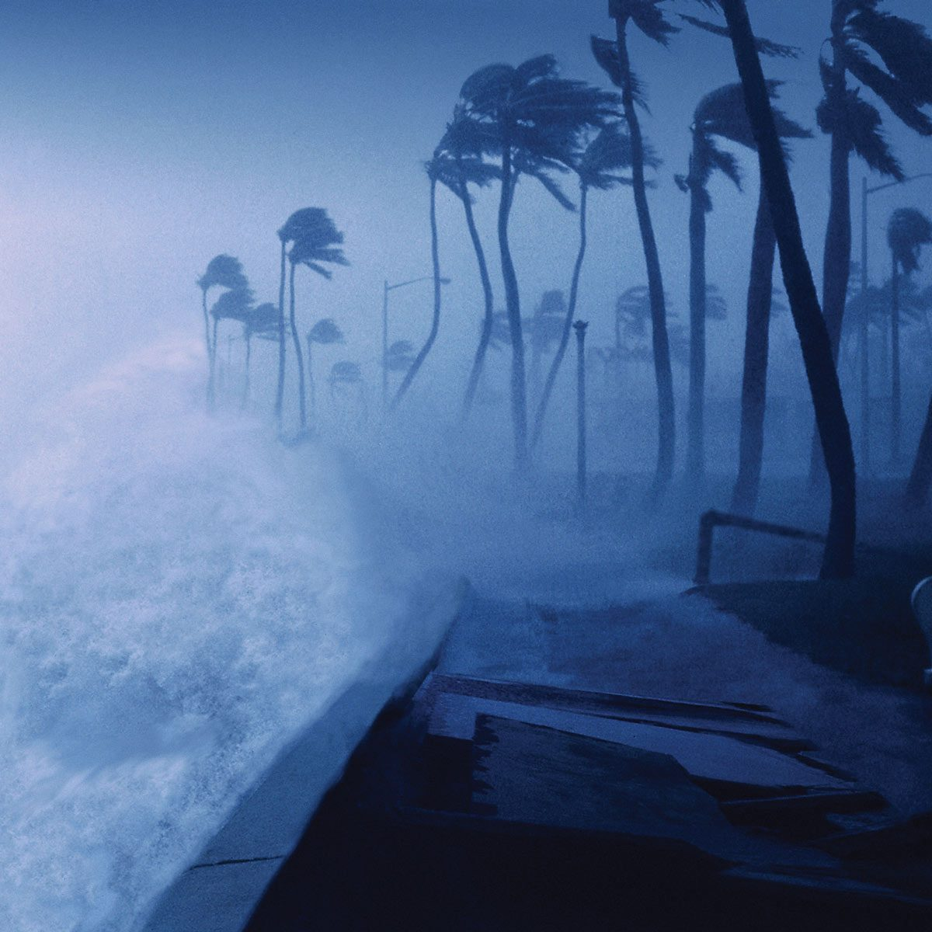
You can write heavy rain and strong wind, but not big rain and fast wind.
This is an example of Collocation. Some words go together; some don’t.

Slide 16
Use the following words to fill in the blanks in the sentences on Page 28 of your textbook.
You may work together.
identify | assert | recruit
arguably | conceive | address
in the light of | consistent with | attribute to

Slide 17
identify | assert | recruit
arguably | conceive | address
in the light of | consistent with | attribute to
1) Learning itself, however, is not something they ______________ as an intentional pursuit; they see it as a natural consequence of carrying out appropriate learning activities.

Slide 18
identify | assert | recruit
arguably | conceive | address
in the light of | consistent with | attribute to
2) __________ the most important advance in biology in decades has been the discovery that RNA molecules can regulate the expression of genes.

Slide 19
identify | assert | recruit
arguably | conceive | address
in the light of | consistent with | attribute to
3) We propose a novel use of mobile communications to permit individuals to _____________ a preference for privacy from video surveillance.

Slide 20
identify | assert | recruit
arguably | conceive | address
in the light of | consistent with | attribute to
4) The study tried to ______________ and explain the relationship between parental mediation and children’s aggression.

Slide 21
identify | assert | recruit
arguably | conceive | address
in the light of | consistent with | attribute to
5) Social values in relation to personal needs are discussed ________________ this experiment.

Slide 22
identify | assert | recruit
arguably | conceive | address
in the light of | consistent with | attribute to
6) The process used to locate and _________________ participants in a qualitative study is important for efficiently obtaining a representative sample.

Slide 23
identify | assert | recruit
arguably | conceive | address
in the light of | consistent with | attribute to
7) Using the 1994 NHIS data, cost of lost productivity __________________ obesity was $3.9 billion and reflected 39.2 million days of lost work.

Slide 24
identify | assert | recruit
arguably | conceive | address
in the light of | consistent with | attribute to
8) It was found that few managers exhibited behaviour _________________ what is described in the literature.

Slide 25
identify | assert | recruit
arguably | conceive | address
in the light of | consistent with | attribute to
9) The book covers well the range of issues which must be ________________ by those wanting to conduct research using the in-depth interviewing method.

Slide 26
Continuing the First Reading
Analysis & Discussion – Page 10
Note: No dedicated results section

Slide 27
Confusion
There is evidence that, except for the verbatim copying of text, many participants were confused as to what behaviour constitutes plagiarism. This theme suggests that participants acknowledged an existence of a concrete and agreed upon definition of plagiarism somewhere ‘out there’, and were able to express some understanding of the more obvious instances of plagiarism. This is evidenced in the following discussion among two students:
P3: Simply, taking the words...like for example in an essay format, taking word for word out of paragraphs things that have been published, and not referencing it, and saying it’s your own. Not referencing something basically, and just putting it in an essay.
P5: Passing off somebody else’s work as your own
P3: Exactly, that’s it. (Group 4, 98-105)
Pages 10/11

Slide 28
Within this theme it was evident that participants were unclear on the university policy on academic misconduct. Examining the current practice at the university, students report being provided with online links to the academic misconduct policy, via an electronic message sent to every student at the commencement of each semester. However, since a formal induction or transition into the scholarship of academic writing is not available to students, the onus is on the student to search for relevant information pertaining to plagiarism, or each academic to ensure that students understand academic integrity.
Page 13

Slide 29
Question
How do the authors incorporate their qualitative data?

Slide 30
The theme of fear represents the anxiety expressed by students regarding the possibility of committing unintentional acts of plagiarism. This fear appears to flow from the discussion threads on confusion. Similar findings in Ashworth, Bannister, and Thorne (1997) and Breen and Maassen (2005) suggest that a combination of university expectations and sanctions, the difficulty in finding clear guidelines on minimising plagiarism, along with the mistaken belief that the most minor errors could result in an allegation of plagiarism increase students’ level of anxiety. Central to the fear is the belief that unintentional plagiarism results in the same consequences as intentional plagiarism
Page 13

Slide 31
Question
How are the other cited studies used in combination with the results?
How does this section compare to a regular IMRD structure?

Slide 32
Conclusion

Slide 33
It is evident that the university’s approach towards plagiarism is not effective. Whilst students were able to clearly define cases of plagiarism, where verbatim text was inserted in a student assignment without due acknowledgement, they were unable to discern the more subtle aspects of attribution of ideas and paraphrasing of text. This confusion appeared to increase the fear of inadvertent plagiarism, which arguably appears to be related to the students’ confusion.
Pages 20/21

Slide 34
This fear appeared to be augmented by an overestimation of the severity of sanctions, along with the perception that the university treats the act of plagiarism very seriously in contrast to how students perceive plagiarism. The other concerning aspect was that students reported negative academic consequences that manifested as a form of academic learned helplessness. This was reported as a decrease in confidence to write an academic paper.

Slide 35
Question
What is the main purpose of this paragraph?

Slide 36
Drawing from Breen and Maassen’s (2005) study, information on plagiarism needs to be specifically covered as a unit in the first semester of study in the first year at university. The students in Breen and Massens’ study also recognised that skill development in time management, critical reading, note-taking, paraphrasing, writing and referencing were also required to prevent academic misconduct. Skill development was also identified by our participants as an important factor to reduce the possibility of plagiarising […]
Page 22

Slide 37
Questions
What is this paragraph doing as part of the conclusion?

Slide 38
Finally, while the results do provide a greater understanding of how students perceive plagiarism and the consequences of those beliefs, caution is needed in drawing strong conclusions due to the study’s exploratory nature. We do not seek to generalise our findings as one would do in a representative survey, given that the only data collection method within this study was a set of one-time focus groups with a relatively small sample of self-selected students in one Australian university. It is proposed that further studies would extend this research, building on the six themes found.
Page 22

Slide 39
Question
What is this paragraph doing?

Slide 40
Page 30 – General to Specific Review
Section | Specificity / Content
Introduction | General – Specific –
Literature Review | General – Specific –
Methods | Specific -
Analysis/Discussion | Specific -
Conclusion | Specific – General –

Slide 41
Language Use in IMRD

Slide 42
Linguistic Analysis of IMRD - Tenses
Which of the four default IMRD sections would you expect to see the most:
Present tense?
Past Tense?
Why?
Introduction
Methods
Results
Discussion

Slide 43
Tenses and IMRD
 | Introduction | Methods | Results | Discussion
Present Tense | High | Low | Low | High
Past Tense | Mid | High | High | Mid
Tenses should be kept consistent within a section

Slide 44
Review: Voice
What are the two voices in English (and Chinese) writing?

Slide 45
Passive Voice and Sentence Struture
Every sentence must have a subject and a verb.
This is true in both Chinese and English
In regular active voice, the subject is the source of the verb’s action; we are describing what the subject is doing
I walk, he studies, they slept

Slide 46
The Passive Voice
…is when the object receiving the verb action becomes the focus of a sentence, not the subject doing it
What’s important is what happens, not who does it

Slide 47
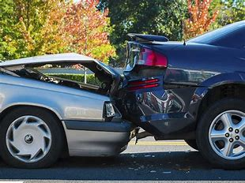
Chinese is no different
他撞了我车！
我车被撞了!

Slide 48
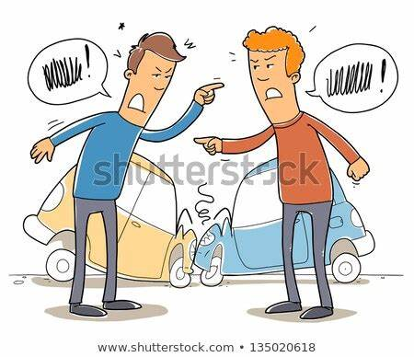
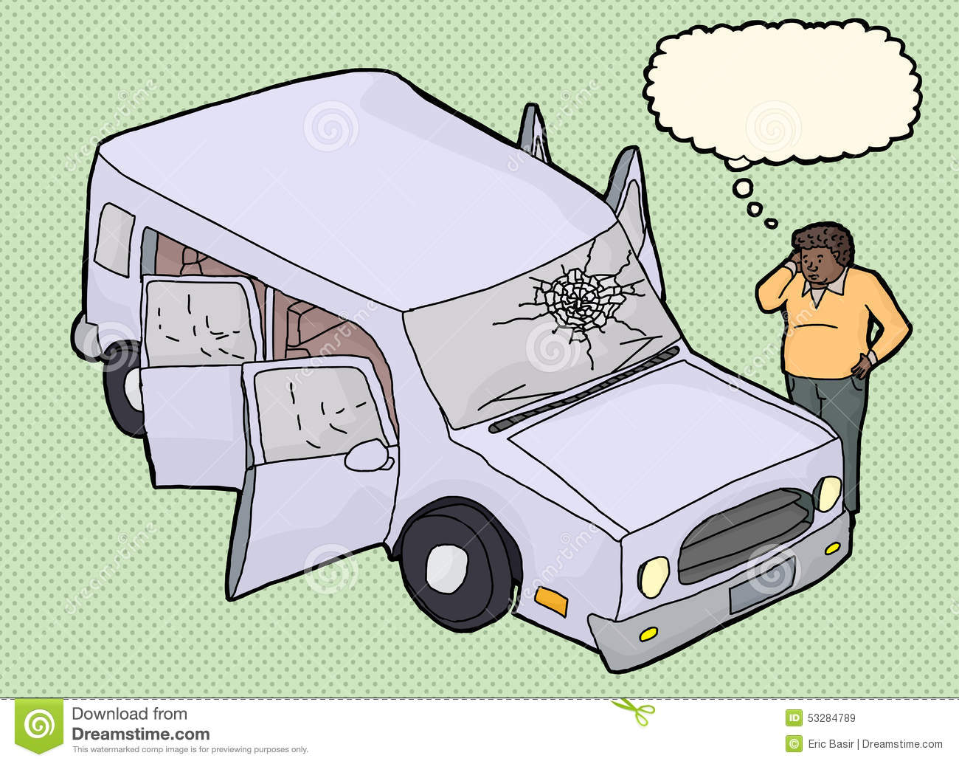
You hit my car!
My car was hit (by you)…
My Car!

Slide 49
How do we write passive voice?
The most common way is be + past form
You were invited by me.
It was unearthed by scientists.
When all is lost, then all is found.

Slide 50
Since the important verb is the verb To Be, that is the verb we conjugate
The festival is held in the winter. (Present)
The festival was held in the winter (Past)

Slide 51
Why is this important for us?
Have a look at the paper’s abstract.

Slide 52
Plagiarism is perceived to be a growing problem and universities are being required to devote increasing time and resources to combating it. Theory and research in psychology show that a thorough understanding of an individual’s view of an issue or problem is an essential requirement for successful change of that person’s attitudes and behaviour. This pilot study explores students’ perceptions of a number of issues relating to plagiarism in an Australian university. In the pilot study, focus groups were held with students across discipline areas, year and mode of study. A thematic analysis revealed six themes of perceptions of plagiarism: confusion, fear, perceived sanctions, perceived seriousness, academic consequences and resentment.

Slide 53

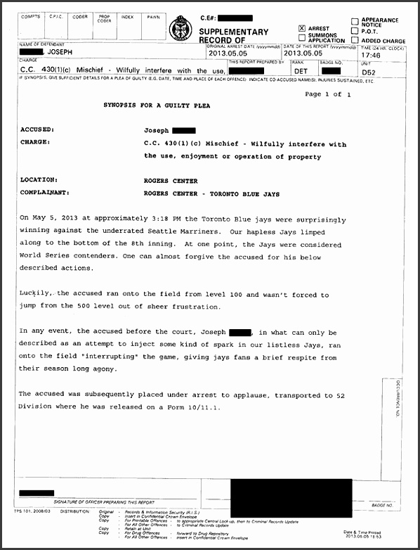
Passive Voice in Formal Writing
Used in Reports and Articles (such as about crime – perpetrator unknown)
“A ring and necklace were stolen this morning.”
“A stolen car was found abandoned…”

Slide 54
Newspaper Articles
O'Toole supports building dead Northern Gateway pipeline, cites Indigenous benefits
2021-08-31
Pipelines and climate change have predictably emerged as issues on the campaign trail ahead of the Sept. 20 election (Canada, 2021)
[Northern Gateway] has faced fierce opposition from those worried about potential environmental harms.
Most recently, longtime Ontario MP Cheryl Gallant created problems for O'Toole after it was revealed she sent correspondence to constituents in her riding warning of a pending "climate emergency lockdown" under a re-elected Liberal government.
She had also earlier posted a video, which has since been removed. A party spokesman said it was taken down because it could be "misconstrued without context.“
O'Toole has also faced criticism from environmental and other climate groups for sticking with a goal of reducing Canada's greenhouse gas emissions to 30 per cent below 2005 levels by 2030

Slide 55
Engineering and computer writing often use this as well
The process was terminated.
The child windows will receive a resize message.
The memory block is being moved.

Slide 56
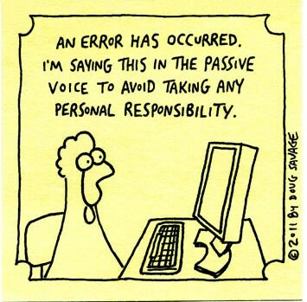
Or generally using it to escape blame

Slide 57



And for our purposes:
Lab reports and articles
“The rats were placed in the maze.”
Who/what placed the rats in the experiment?
The scientists, who else?

Slide 58
When to use Passive Voice?
When what happens is more important than the subject
When it is obvious who did something (Lab report)
When we don’t know who or what does something (Crime report)
To avoid blaming someone or escape blame
Sometimes seen as more formal

Slide 59
Guidelines
The APA recommends that verb tenses and voices should be used carefully. Try not to be reluctant to utilize the active voice – particularly in the Discussion section, where it is imperative to express that it is you supposing certain things and having specific assessments. In the Methods section, it is satisfactory to break the dullness of numerous passive voice sentences with the usage of the active voice.
https://www.enago.com/academy/active-and-passive-voice-in-academic-writing/#:~:text=In%20academic%20writing%2C%20passive%20voice,from%20native%20language%20experts%20now!

Slide 60
A response on Quora (John Geare, 2015) sums up the required balance in a succinct manner:
In academic writing, passive voice is used to describe a process, the results of study, or similar material which is objective in nature. But active voice is used to describe actions.
John Geare (2015, August 29) Why shouldn’t we use a passive voice in academic writing? Retrieved from https://www.quora.com/Why-shouldnt-we-use-a-passive-voice-in-academic-writing

Slide 61
Linguistic Analysis of IMRD: Passive Voice
Which of the four default IMRD sections would you expect to use the most passive voice
Why?
Introduction
Methods
Results
Discussion

Slide 62
Linguistic Analysis of IMRD: Citations & References
Which of the four default IMRD sections would you expect to see the most citation and references?
Why?
Introduction
Methods
Results
Discussion

Slide 63
Linguistic Analysis of IMRD: Commentary
Which of the four default IMRD sections would you expect to see the most commentary?
Why?
Introduction
Methods
Results
Discussion

Slide 64
 | Introduction | Methods | Results | Discussion
Passive Voice | Low | High | Variable | Variable
Citations & References | High | Low | Variable | High
Commentary | High | Low | Variable | High

Slide 65
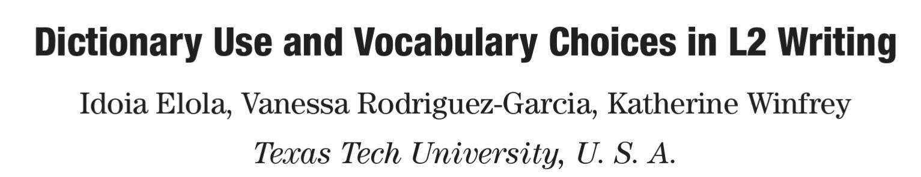
Next Week
Unit 3 Paper (P. 71)

